Slide 1

The Generations After
Year in Review

Slide 2
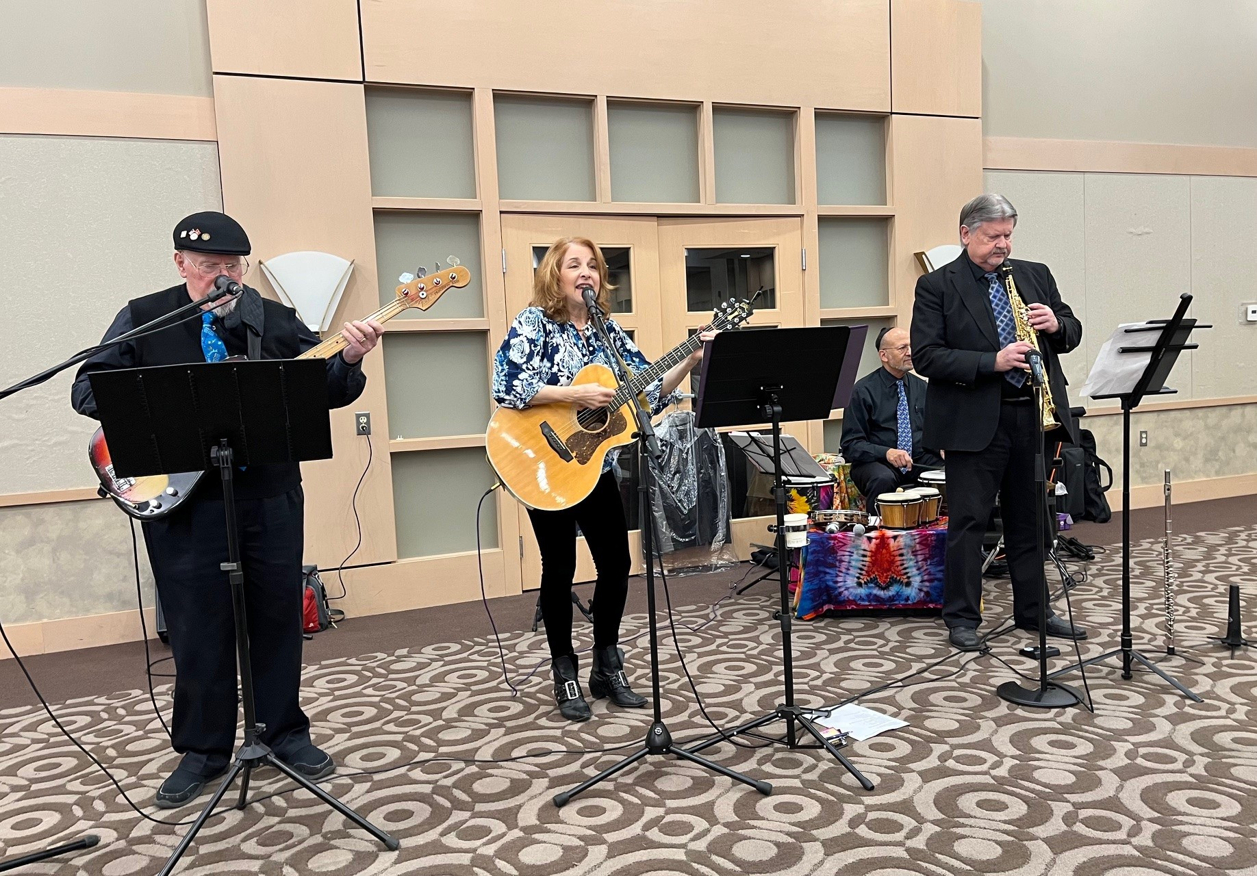
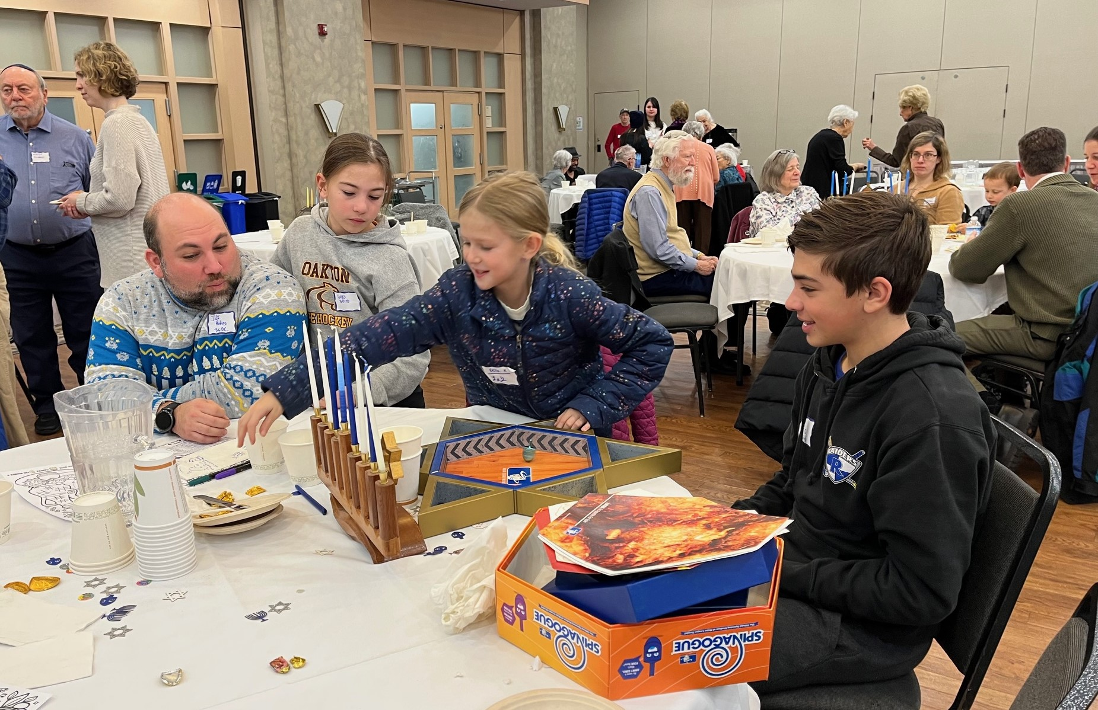
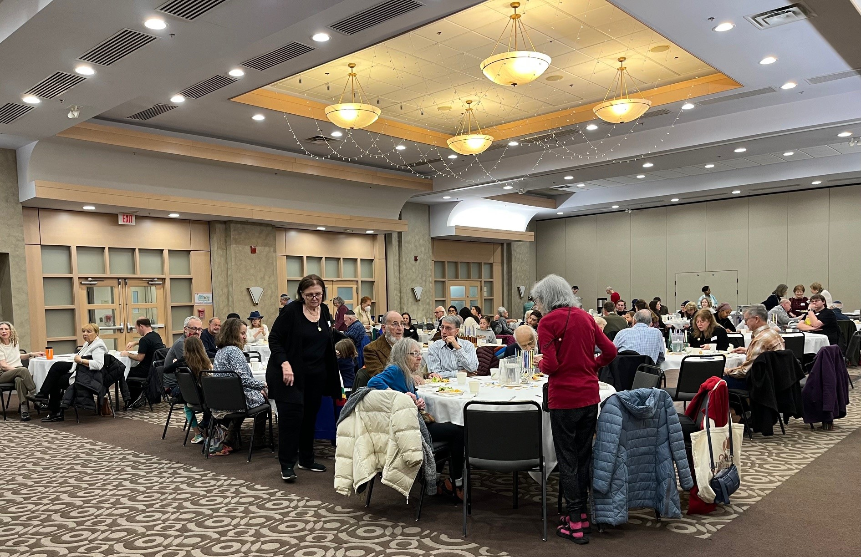
Chanukah Party
December 15, 2024

Slide 3
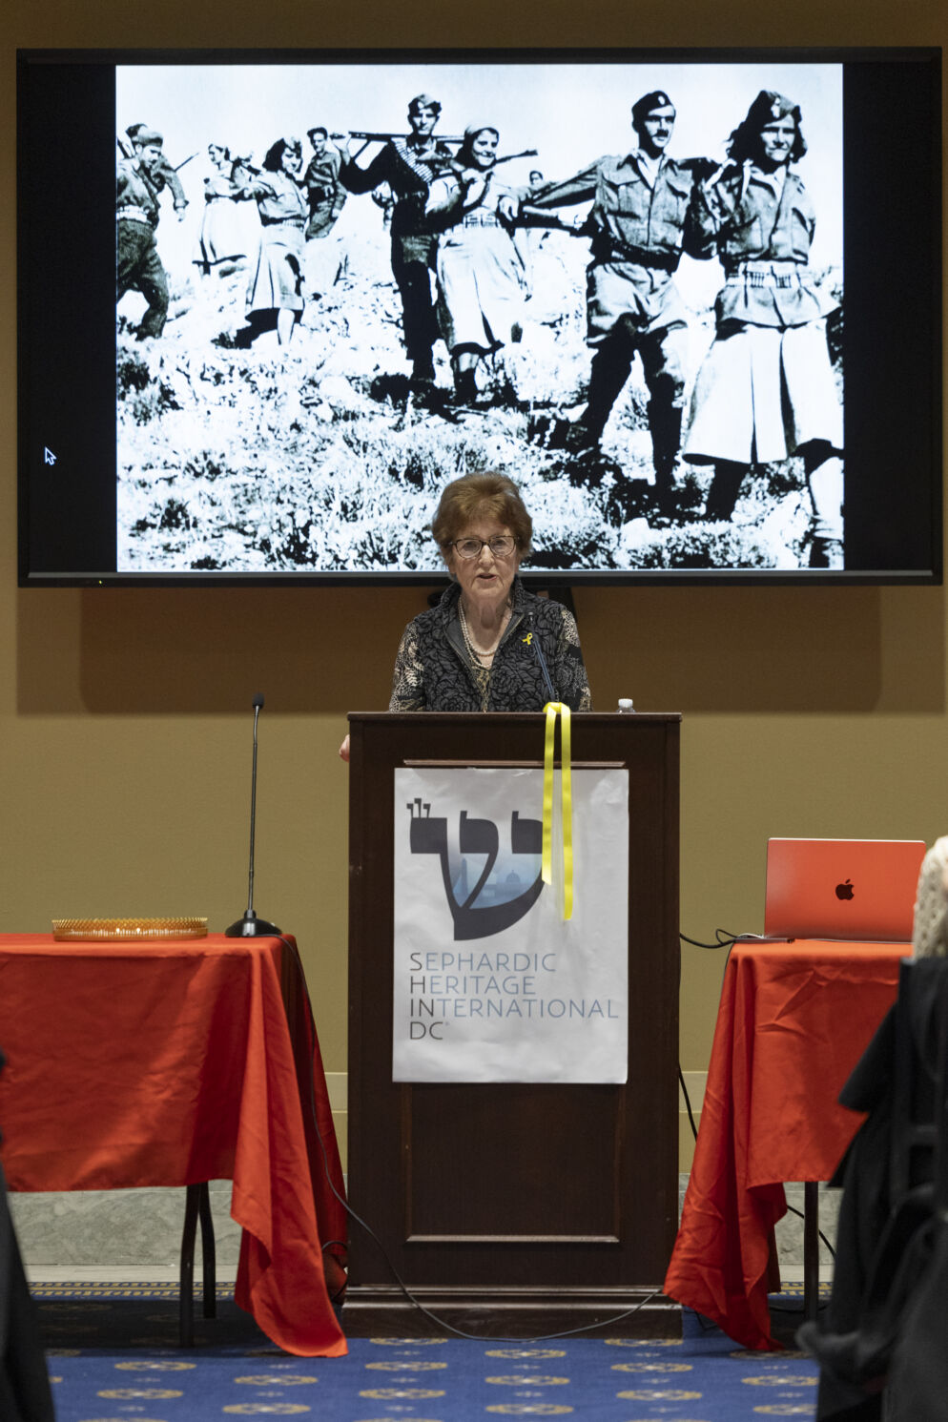
Survivor Ninetta Matsa Feldman spoke about the fate of Greek Jews at SHIN-DC’s annual Congressional Holocaust Commemoration, January 23, 2025.
Co-sponsor, The Generations After
Photo by Shmulik Almany/SHIN-DC.

Slide 4
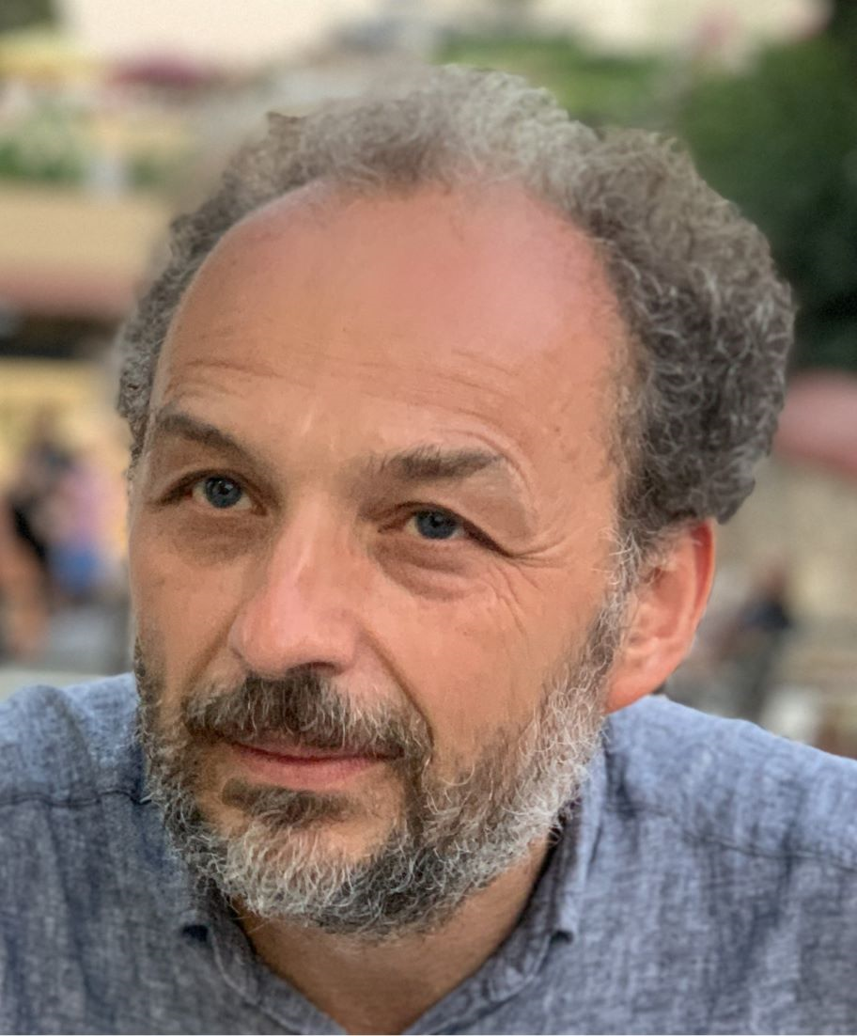
Jewish Ukraine, March 23, 2025, featuring Vadim Altskam

Slide 5
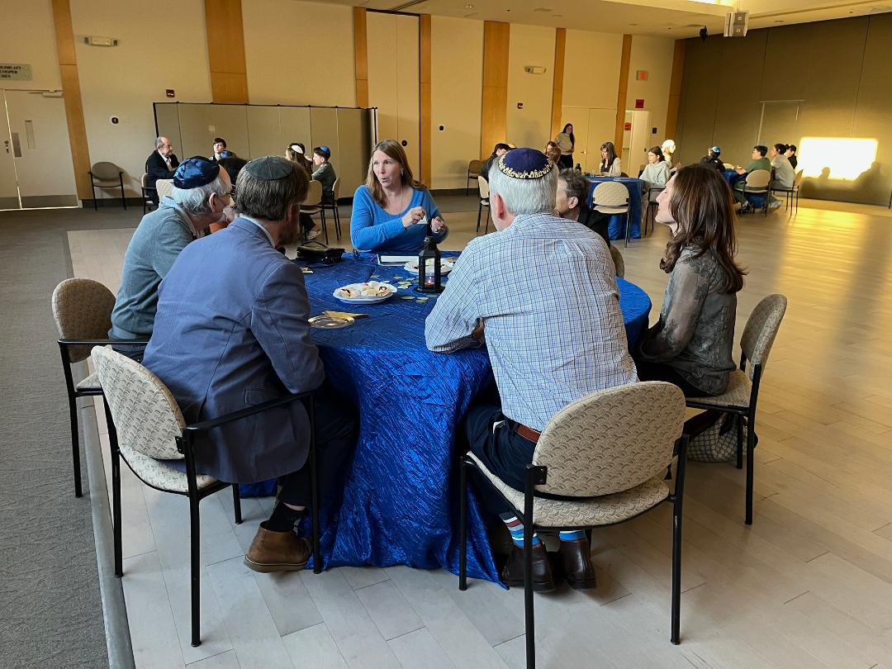
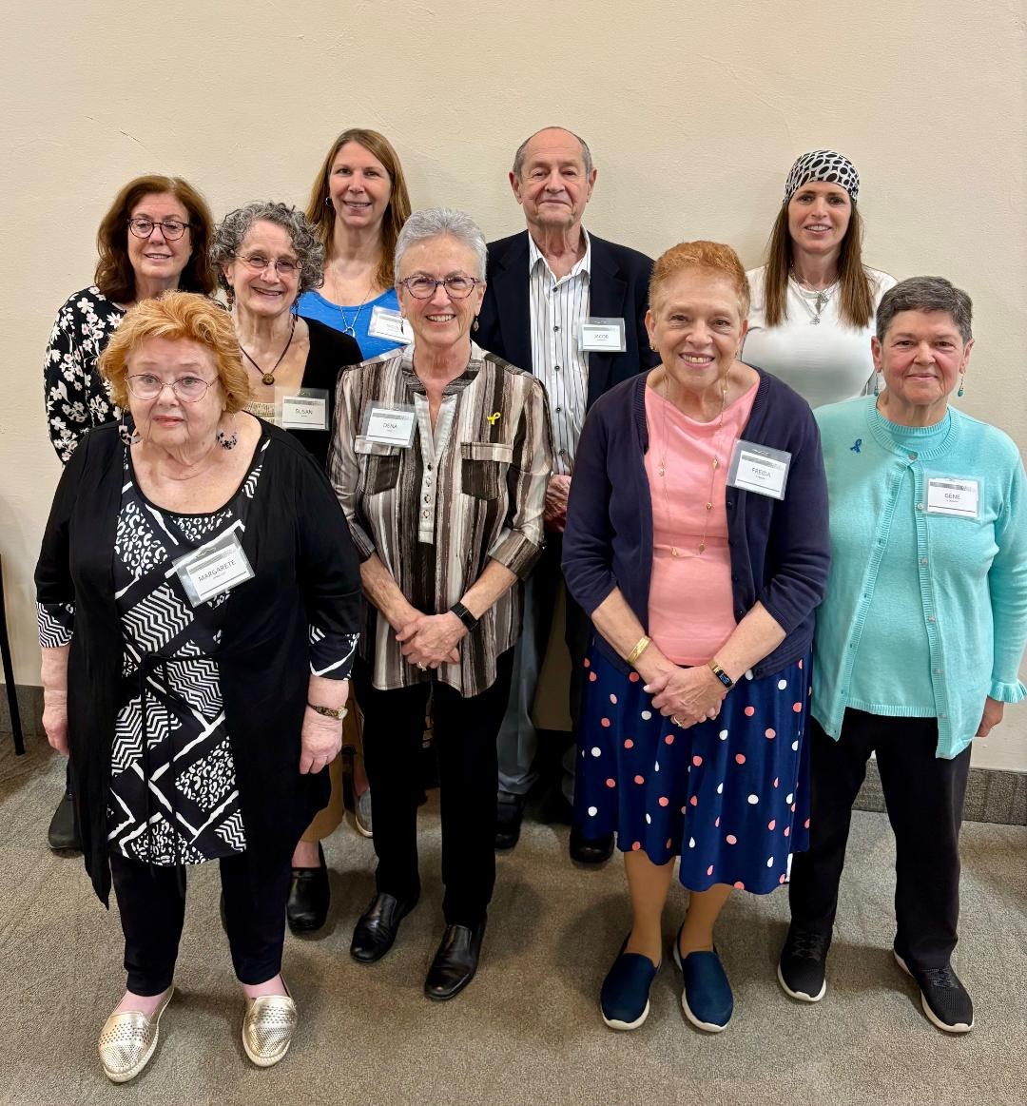
GenAfter Speakers’ Bureau Members Congregation B’nai Tzedek, April 23, 2025

Slide 6
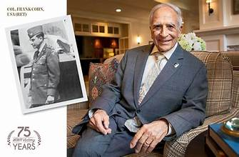
GenAfter co-sponsored the annual JCRC Yom Hashoah Commemoration, April 27, 2025
Survivor and GenAfter member Frank Cohn
was the speaker.

Slide 7
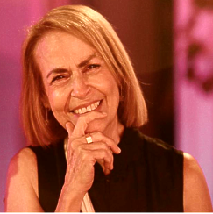


From Life to Rebirth: What Can We Learn From Our Survivor Parents, May 4, 2025
Professor Hanna Yablonka

Slide 8
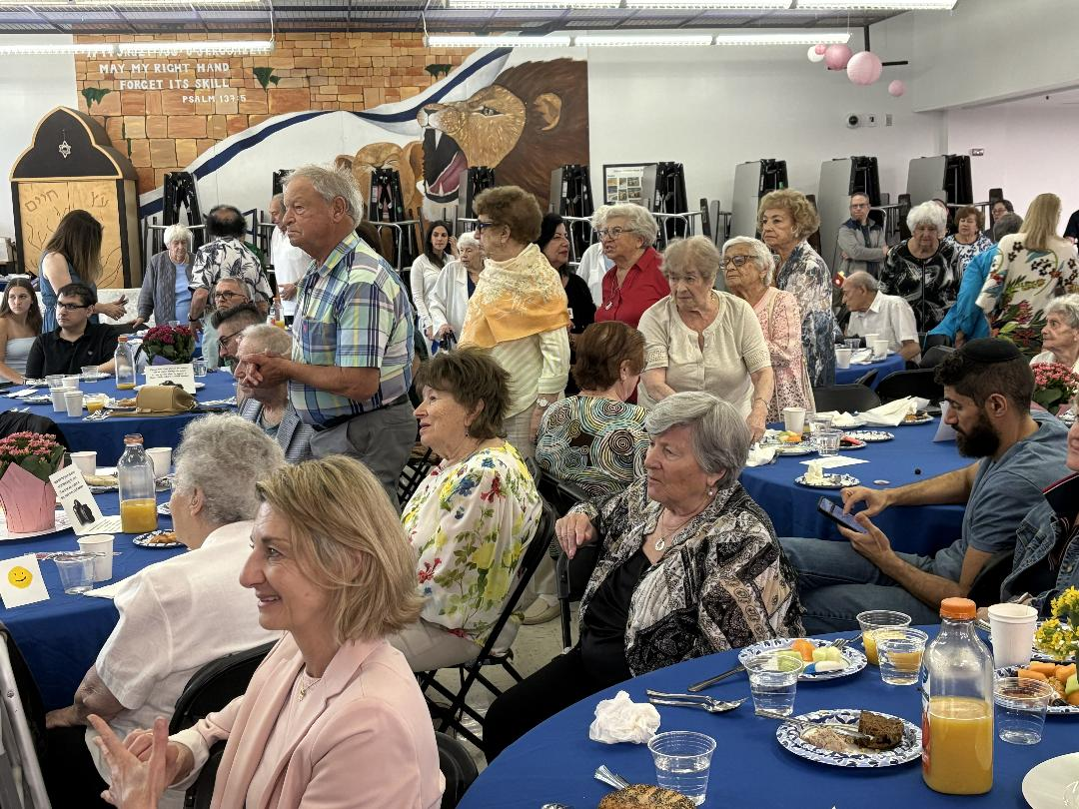
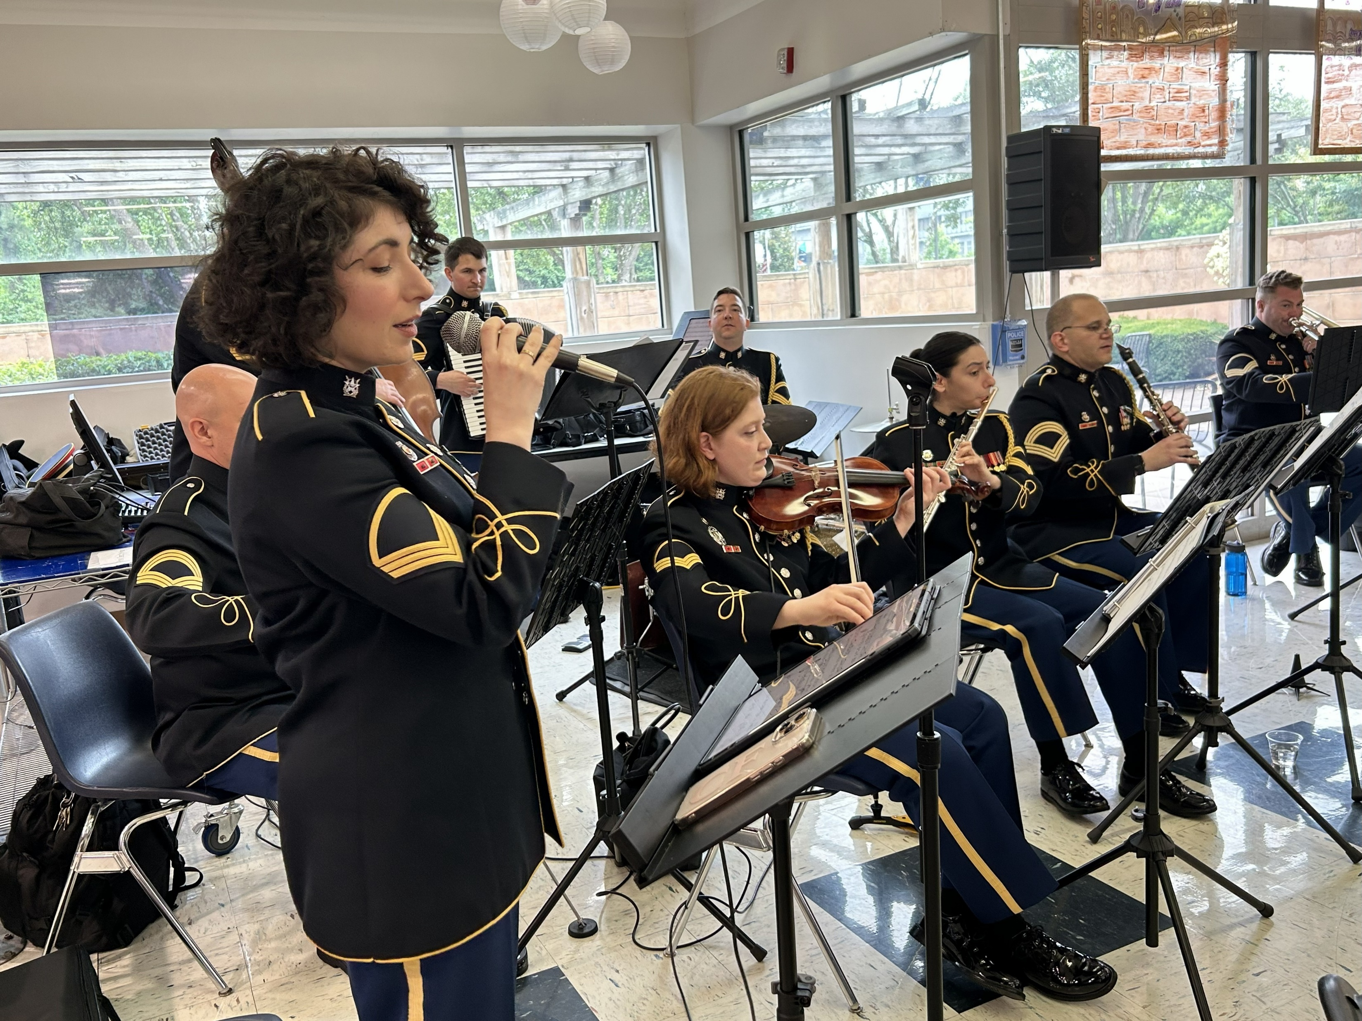
Holocaust Survivors Day Co-Sponsored with 3GDC
June 8, 2025

Slide 9
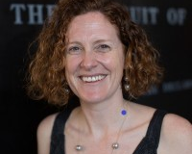
DISPLACED: THE STORY BEHIND DP CAMPS
July 20, 2025
Kierra Crago-Schneider

Slide 10
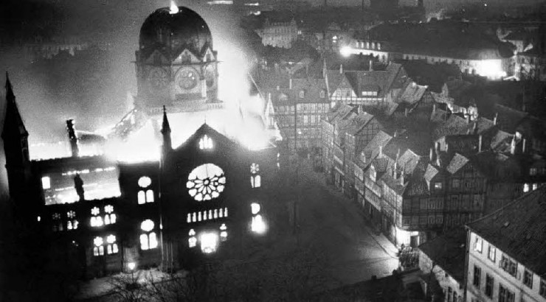
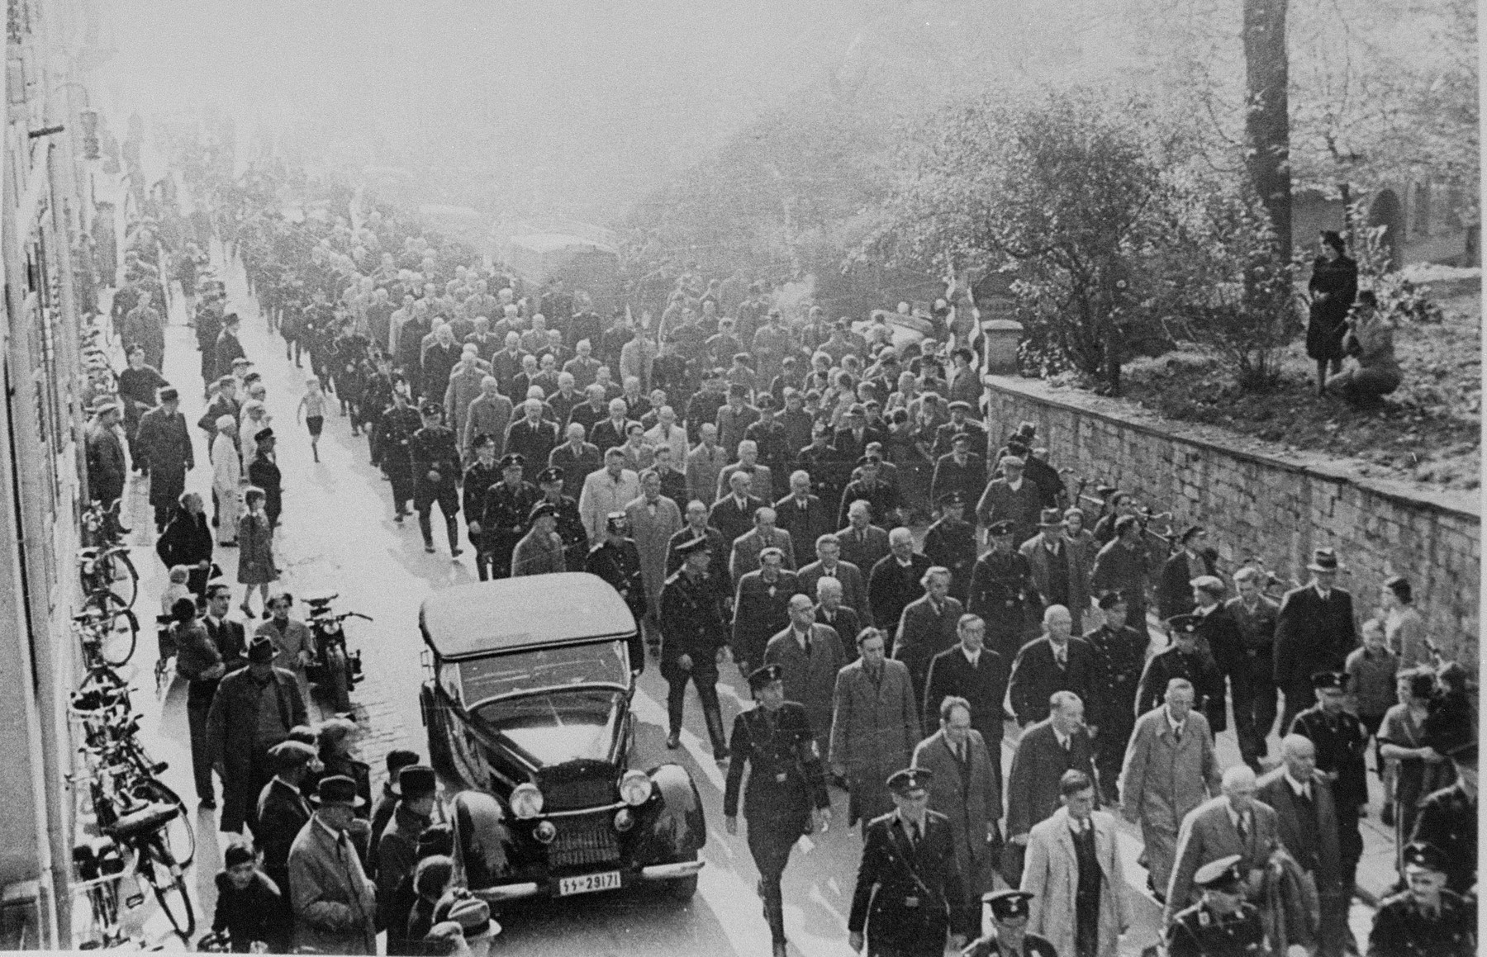
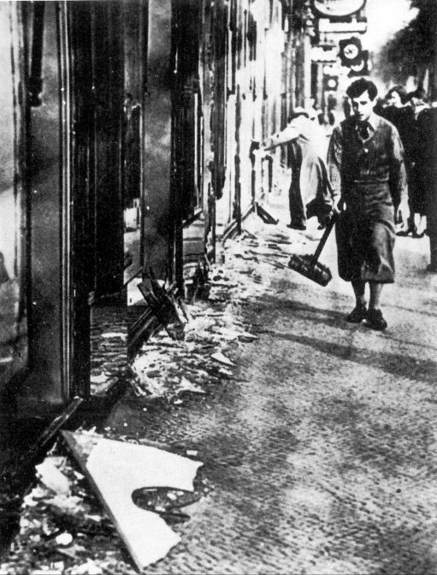
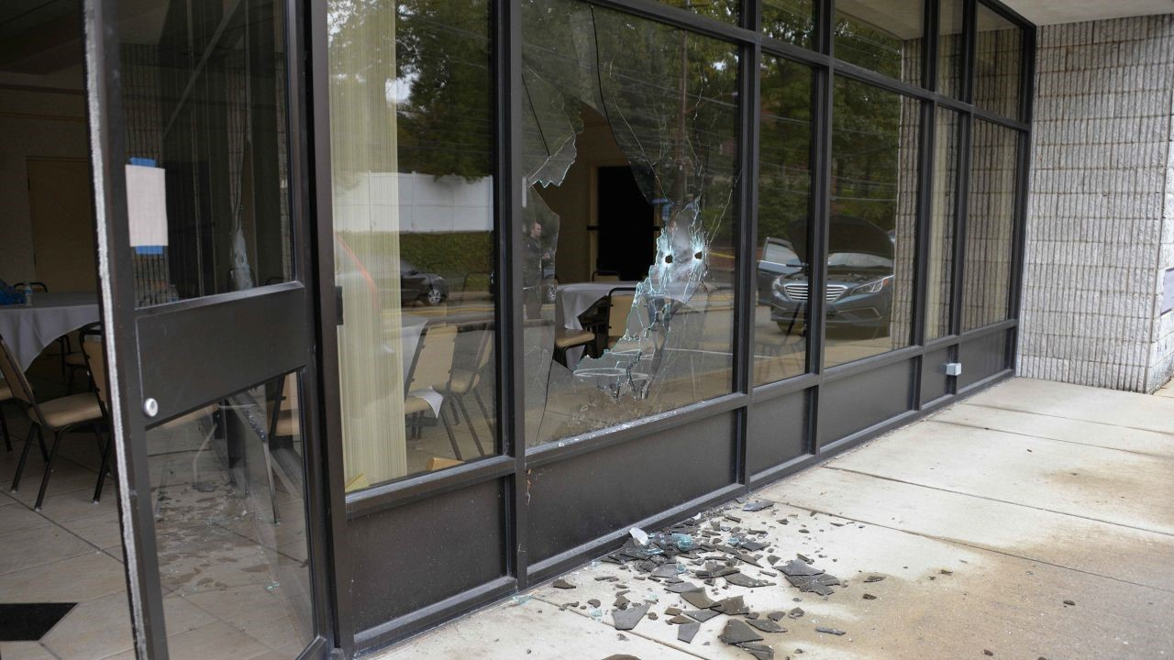
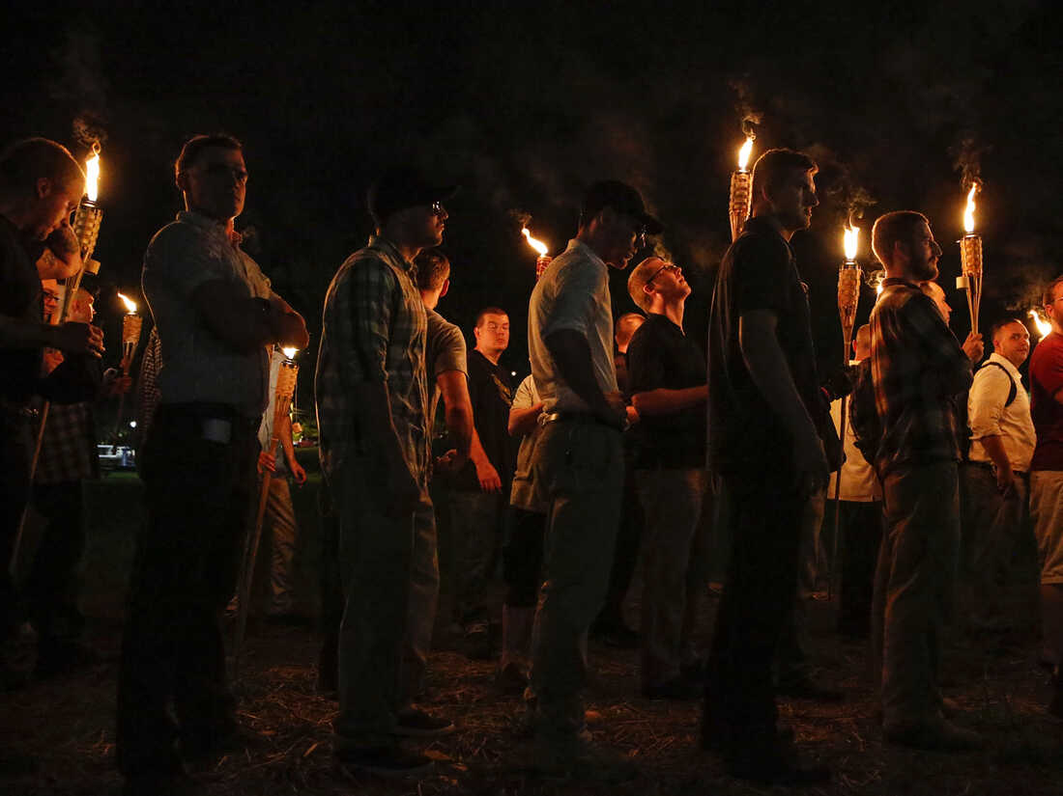
Kristallnacht: Could It Happen Again? What Should We Do?
November 9, 2025

Slide 11
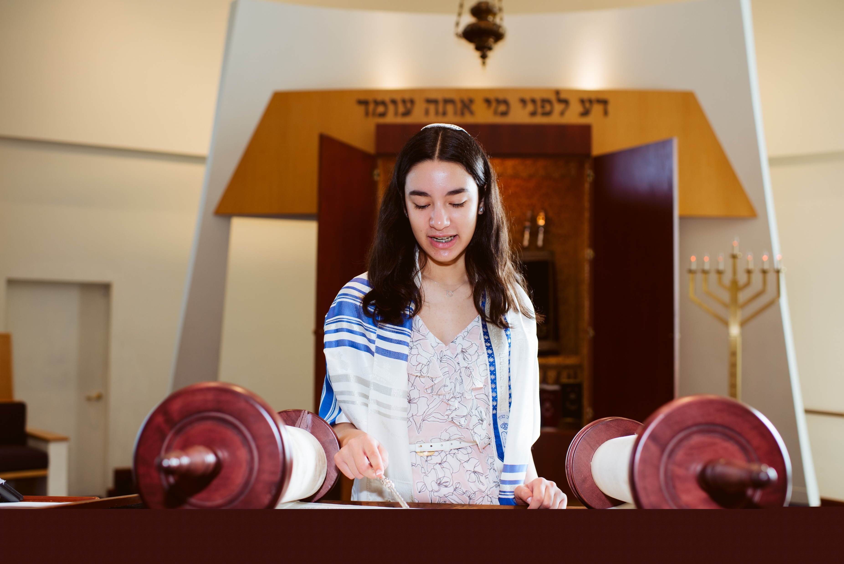
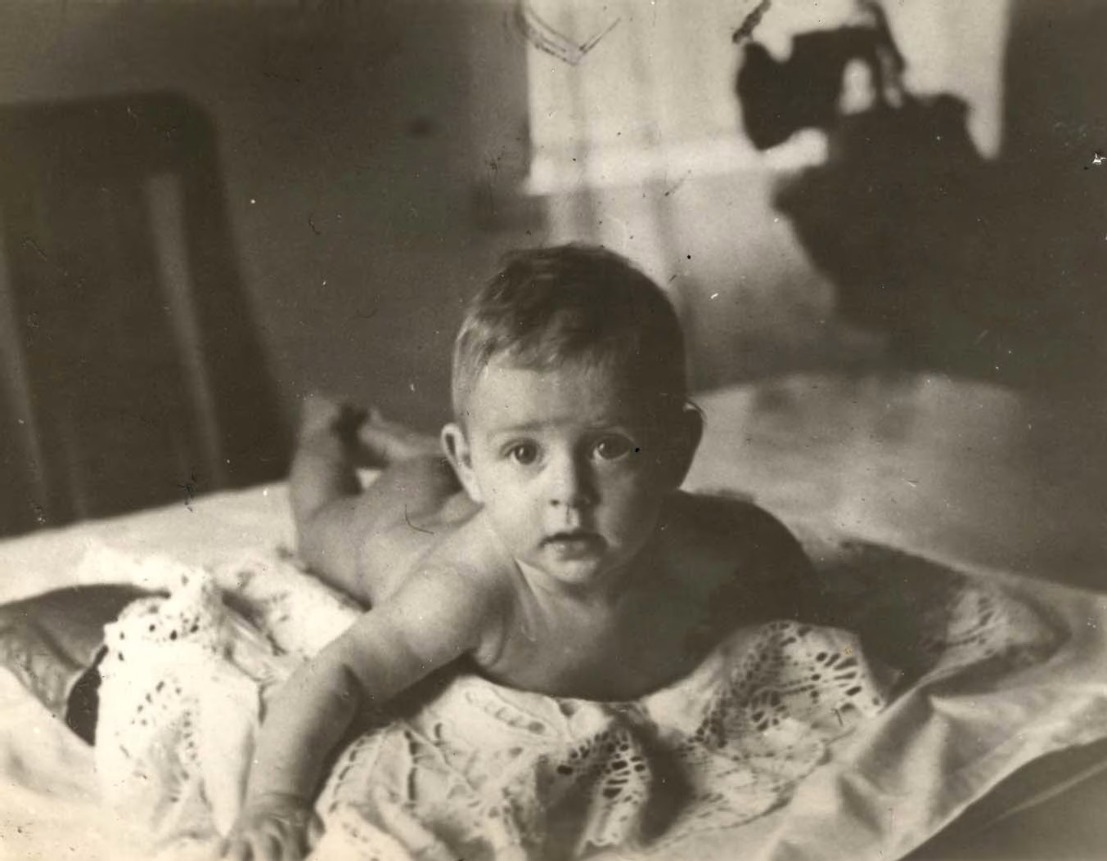
Remember a Child
Abby Blackman remembered Friedele Sobelevitch. Friedele was from the same Lithuanian town as Abby’s great grandparents.

Slide 12
Remember A Child 2025
GenAfter Coordinator Barbara Brandys has paired 60 b’nai mitzvah with children who were murdered during the Shoah.
She provided each with biographical information about the child and his/her family as well as a photo whenever possible.
Their memories live on.

Slide 13






2025 GenAfter Book Group Selections

Slide 14
Become a member and see how much more we can achieve together!
www.generationafterdc.org

